Slide 1
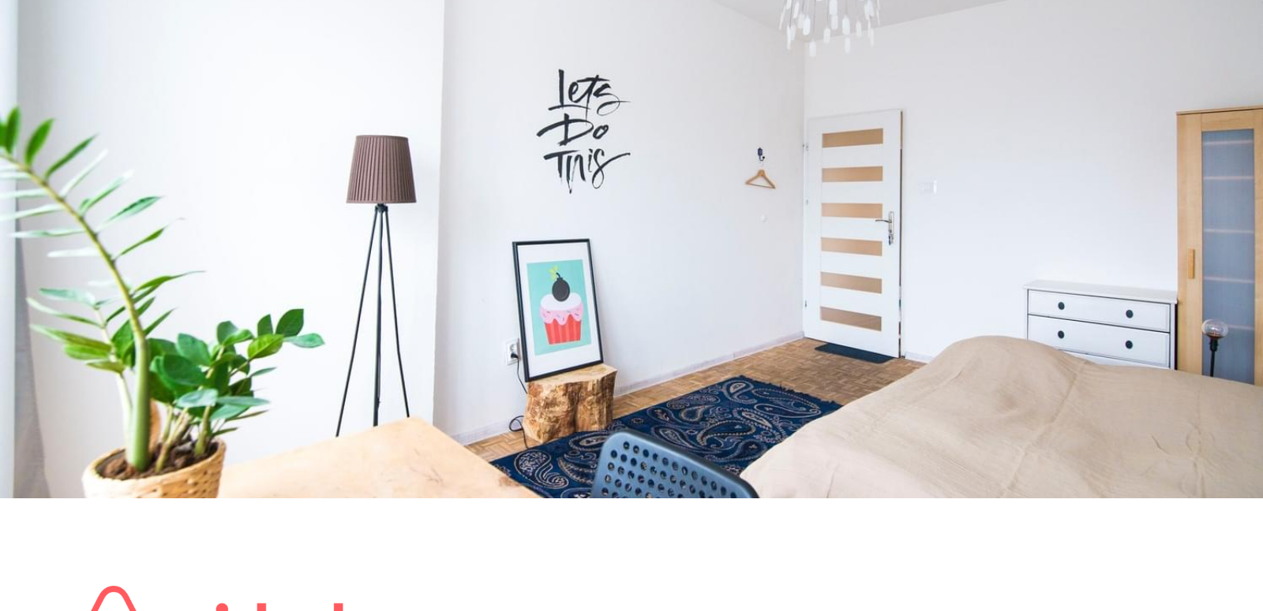
Pitch Deck
Book rooms with locals rather than hotels

Slide 2
Problem
Price is an important concern for customer booking travel online.
Hotels leave you disconnected from the city and its culture.
No easy way exists to book a room with a local or become a host.

Slide 3
Solution
A web platform where users can rent out their space to host travelers to.
Save Money when traveling. Make Money when hosting.
Share culture by making a local connection to the city.

Slide 4
Market Validation
couchsurfing.com
craigslist.com
670,000
17,000
TOTAL USERS
TEMPORARY HOUSING LISTINGS (In SF & and NYC from 7/09 to 7/16)

Slide 5
Market Size
$2+ Billion:
$560+ Million:
$84 Million:
from trips booked (worldwide)
budget & online
15% share of market.

Slide 6
Product

Slide 7
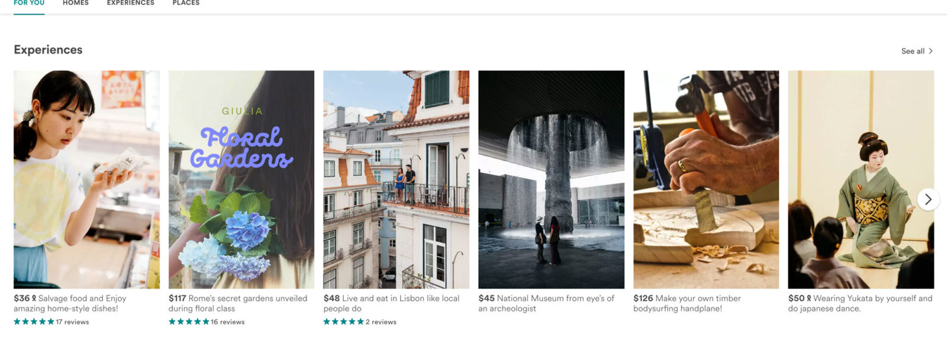
Search by city

Slide 8
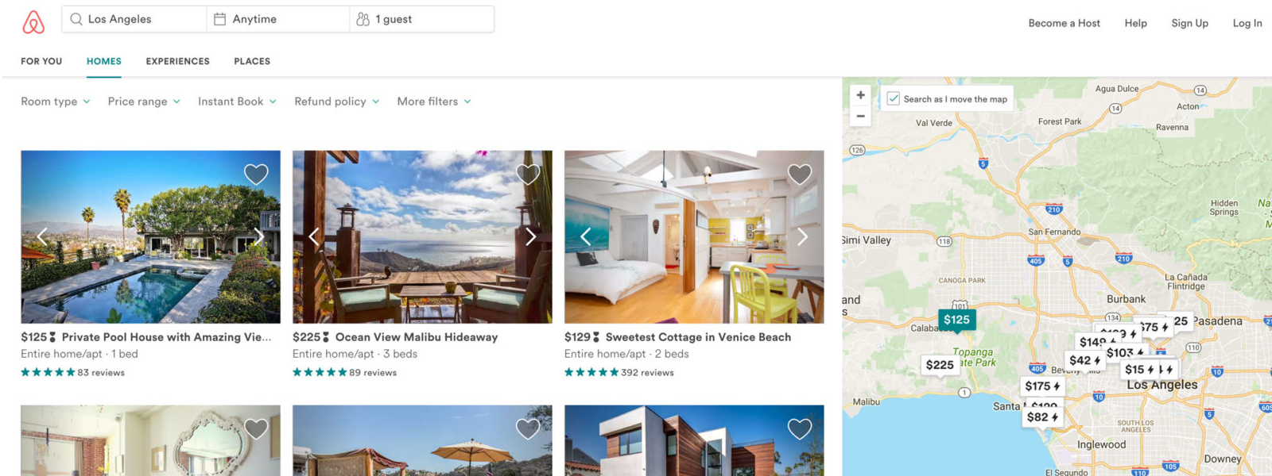
Review listings

Slide 9
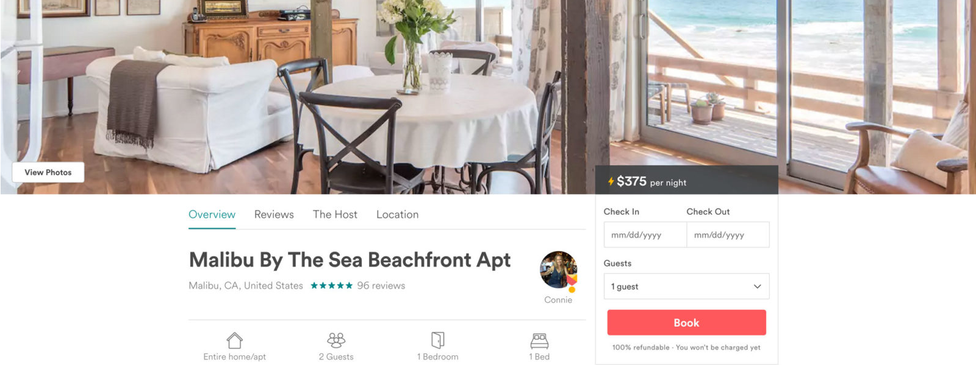
Book it!

Slide 10
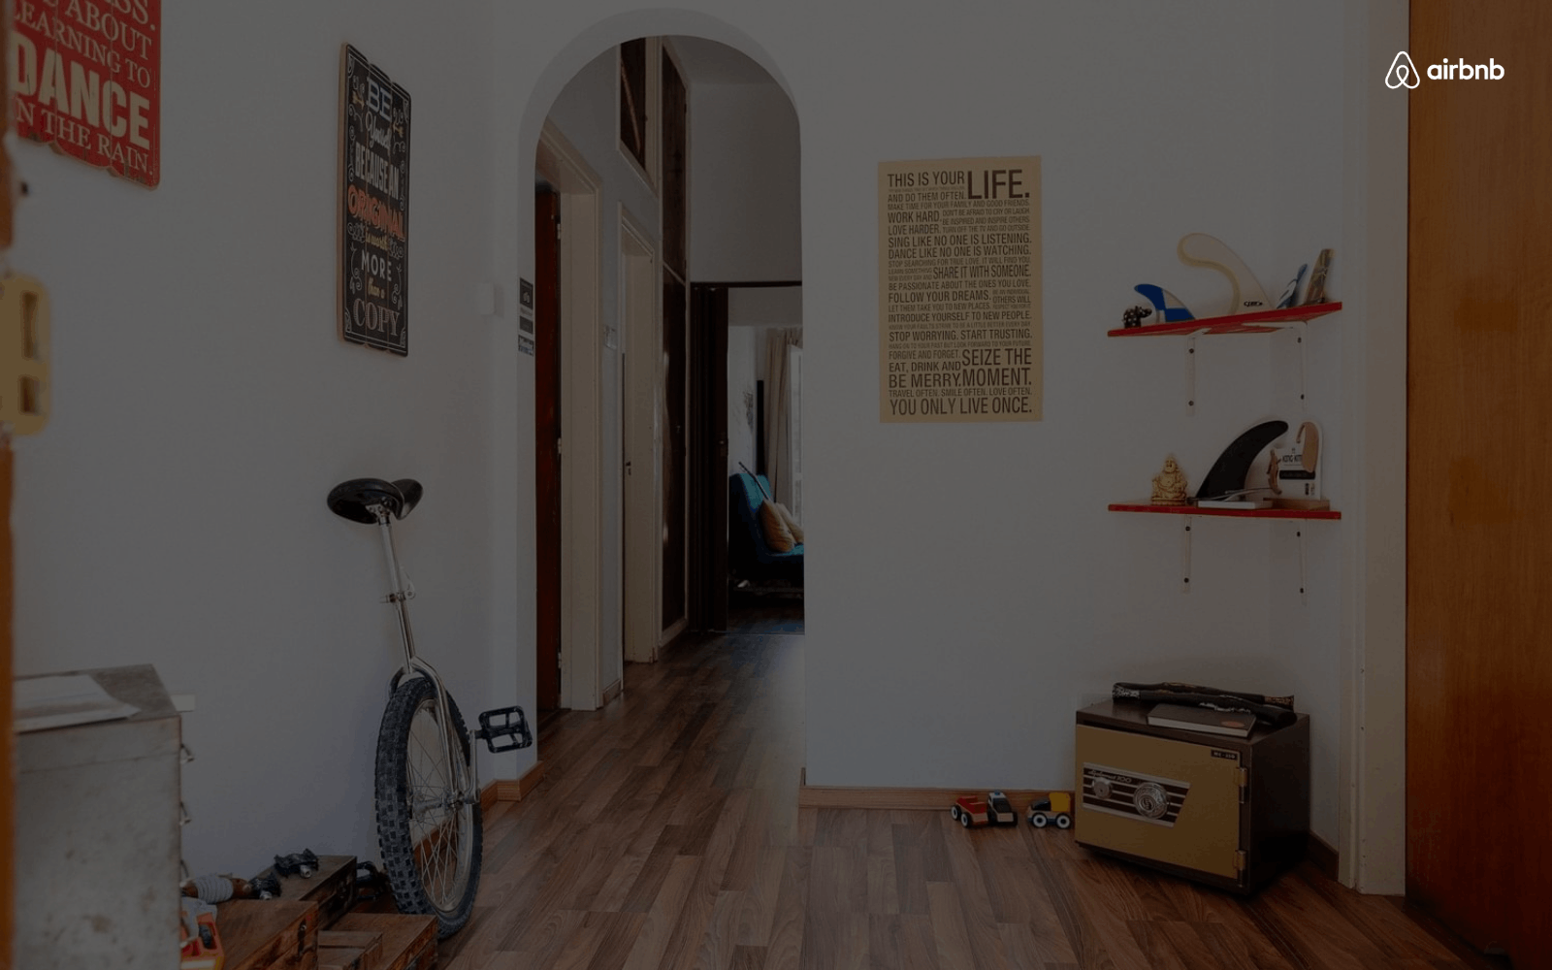
Business Model
We take a 10% commission on each transaction
$84 Million Dollars.
$25 Dollars.
Trips with AirBnB
Average Fee
15% of Available Market
$80/night for 3 nights

Slide 11
Market Adoption
EVENTS
PARTNERSHIPS
CRAIGSLIST
Target events monthly
Cheap/alternative travel
Dual posting feature
Octoberfest (6M)
Kayak
Eurocup (3M)
Goloco

Slide 12
Competition

Slide 13
AFFORDABLE
Competitor
You
OFFLINE TRANSACTION
ONLINE TRANSACTION
Competitor
Competitor
EXPENSIVE

Slide 14
Competitive Advantage
First to Market
Host Incentive
Ease of Use
Profiles
for transaction-based temporary housing site
they can make money over couchsurfing.com
search by price, location & check-in/check-out dates
browse host profiles,
and book in 3 clicks

Slide 15
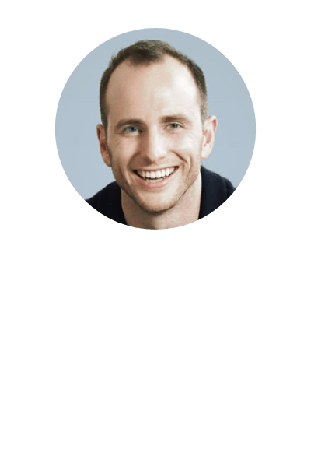
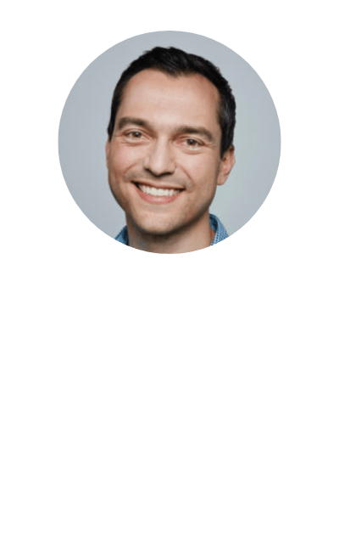
Team
Joe Gebbia
Created Facebook Apps "Your neighbors" (75,000 users). Computer Science from Harvard Nate. Worked @ Microsoft, OPNET Technologies and Batiq.
Brian Chesky
Nathan Blecharcyk
User Interface & PR
Business Development & Brand
Developer
Holds a patent for his product, Critbuns(R). Has dual BFA's in graphic design and industrial design from Rhode Island School of Design (RISD).
Founder of Brian Chesky Inc, industrial design consultant. Has a BFA in industrial design from RISD.

Slide 16
Press
AirBed & Breakfast
is a fun approach to CouchSurfing

Slide 17
User Testimonials

Slide 18
Financial
$500K Angel Round
We are looking for 12 months’ financing to reach 80,000 transactions on AirBed&Breakfast. That translates into $2M Revenue over 12 months
initial investment opportunity

